Slide 1

Business Problem:
To extract reviews of a product from AMAZON and perform sentiment analysis
Objective:
Most of the people are expressing their view by posting it on social media and e-commerce sites platforms about a product.
We need to understand the liking or disliking of that product to help the organization to make some decisions about the production and supply of the same in the market.
So here consider extracting reviews from ecommerce websites and analyze them to satisfy the objective.

Slide 2
<<Project 88- Review Analysis of Product>>
<Group 5>
<Varun>
<09/01/2022>

Slide 3
Product Summary:
Product: Floating Bookshelf
1)What is a Floating Bookshelf?
A floating bookshelf is a form of shelf, with its wall fixings hidden within the shelf board, with no visible supporting brackets.
2) Purpose of choosing this product?
These shelves are a great addition for the idea of effective office space hence saving the space used by furniture like table, books cabinet etc.
These shelves make the most of unused space and can organize rooms while adding a touch of personality to walls.
Floating bookshelves work well for organizing and displaying books, plants, toys, trophies, photos, art, cooking tools and pretty much anything else you can think of.

Slide 4
Project Architecture
Product Understanding
Data Extraction,
Understanding
Data Modelling
Model Evaluation
Deploy
Iterate
Data Preparation
Sentiment Analysis

Slide 5
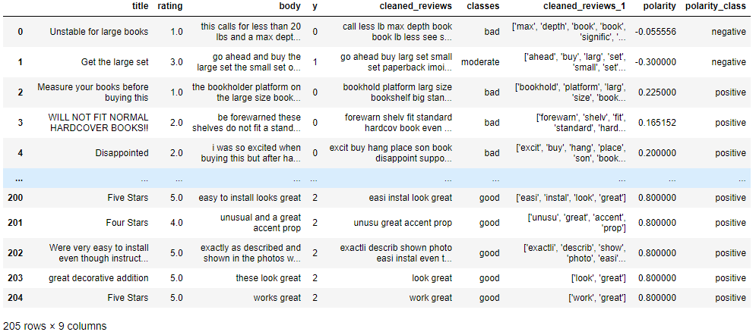
Data set details
205 rows
9 columns
Rating- 3.2 stars
No null values
No Duplicate rows

Slide 6
Exploratory Data Analysis (EDA)
Classification:
REVIEW TYPE | OCCURENCE | TOTAL RECORDS
POSITIVE | 79 | 205
NEUTRAL | 68 | 205
NEGATIVE | 58 | 205
The total number of reviews extracted is 205.
Majority of the reviews fall into the positive class which is 79.
The review count for the negative class is 68.
The remnant reviews fall into neutral class which is 58.

Slide 7

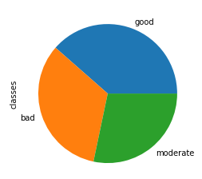
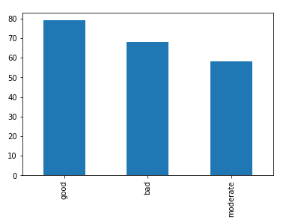
PIE CHART
EDA
BAR GRAPH
Inference: The pie chart represents the distribution of the reviews based on 3 different classes which is good, moderate and bad.
Inference: The bar graph represents the distribution of the reviews based on the counts respectively.
We can observe here that the good class peaks upto 80.

Slide 8
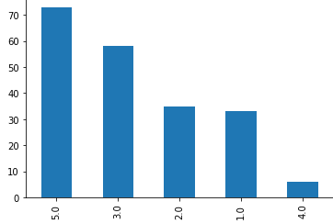
Classification according to ratings
CLASS RATING | FREQUENCY
VERY GOOD | 73
GOOD | 6
MODERATE | 58
BAD | 35
POOR | 33
Inference: The bar graph represents the distribution of the reviews, rating displays the counts respectively.
We can observe here that the very good class has the highest number of count that is 73.

Slide 9
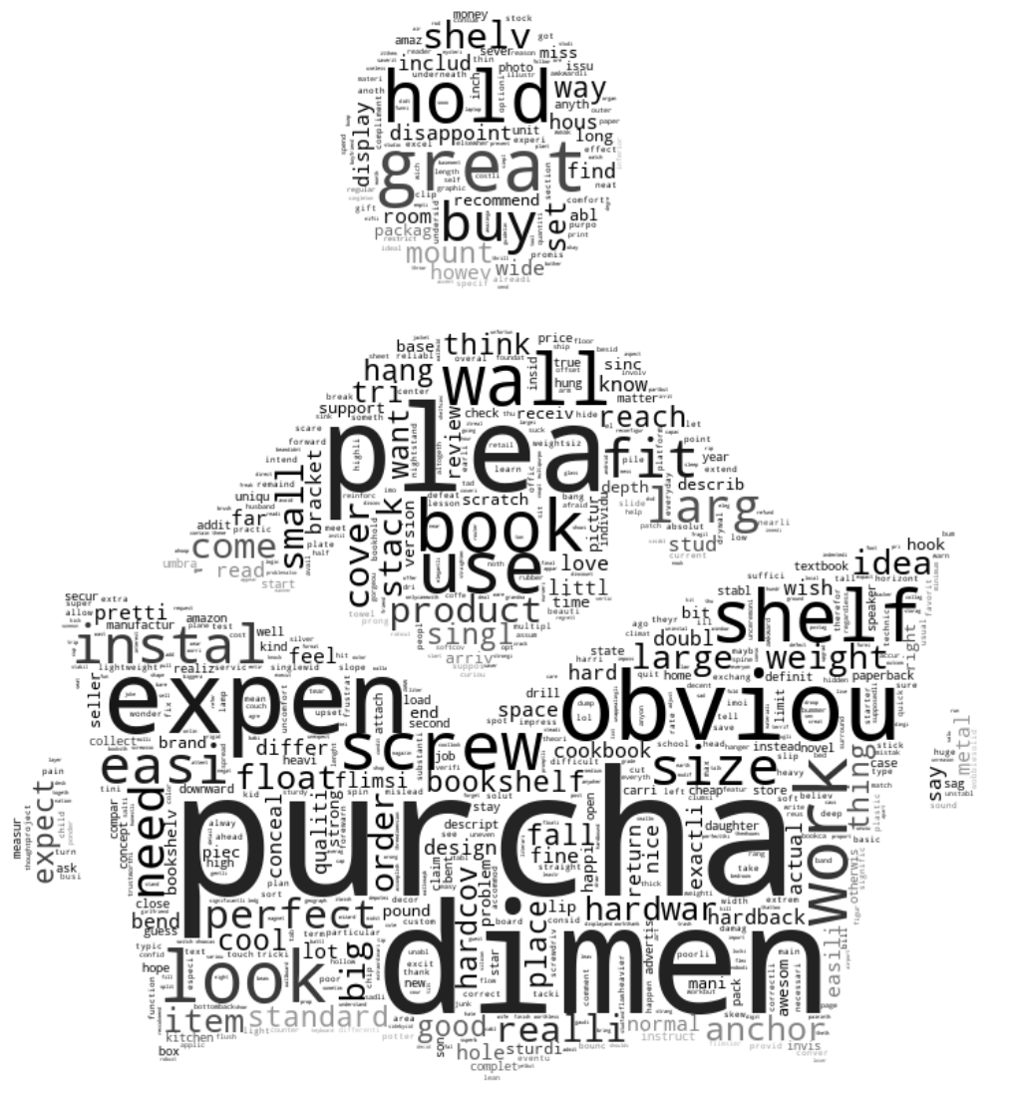
Information Retrieval
WORD CLOUD OF TEXT CORPUS

Slide 10
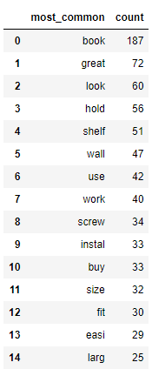
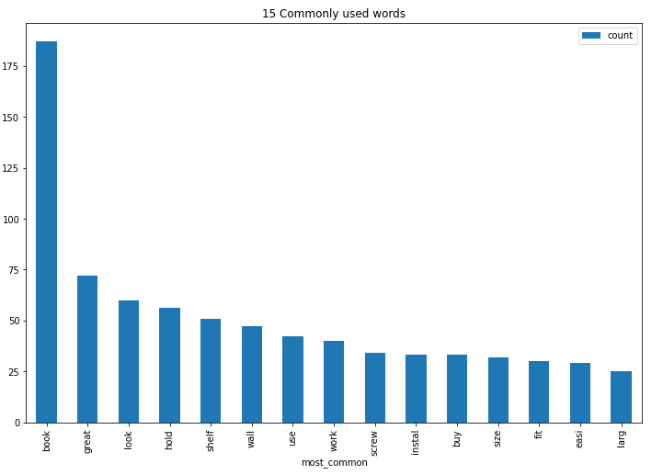
Information Retrieval
TOP 10 MOST OCCURRED WORDS

Slide 11
MODEL BUILDING
Model | Accuracy
SVM | 83%
LOGISTIC REGRESSION | 83%
NAIVE BAYES | 73%
MULTINOMIAL NAIVE BAYES | 78%
RANDOM FOREST | 68%
LGBM | 63%
XGBM | 76%
ADA BOOST | 76%

Slide 12
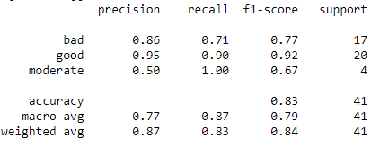
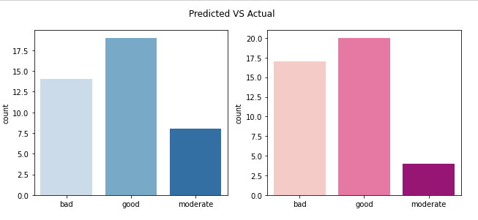
Template for Model results
Model - LOGISTIC REGRESSION
Model Performance:
Data Partition details: 80% training data 20% test data
Graph:

Slide 13
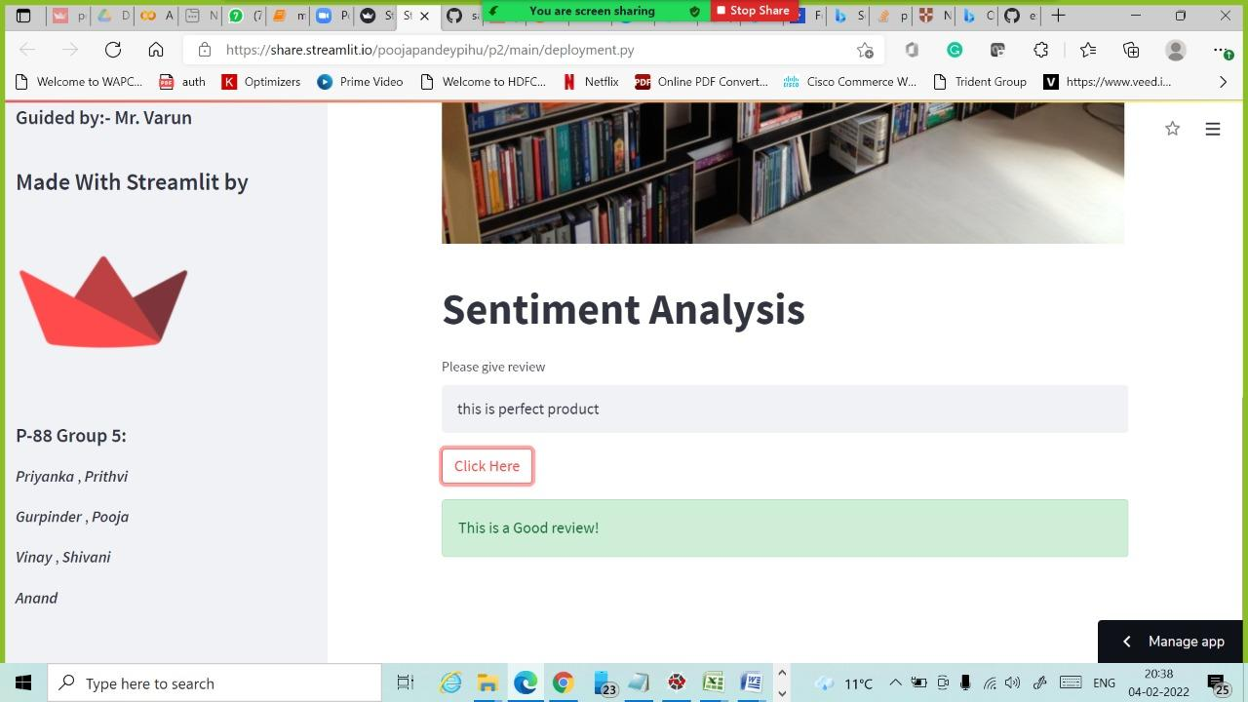
Positive Review

Slide 14
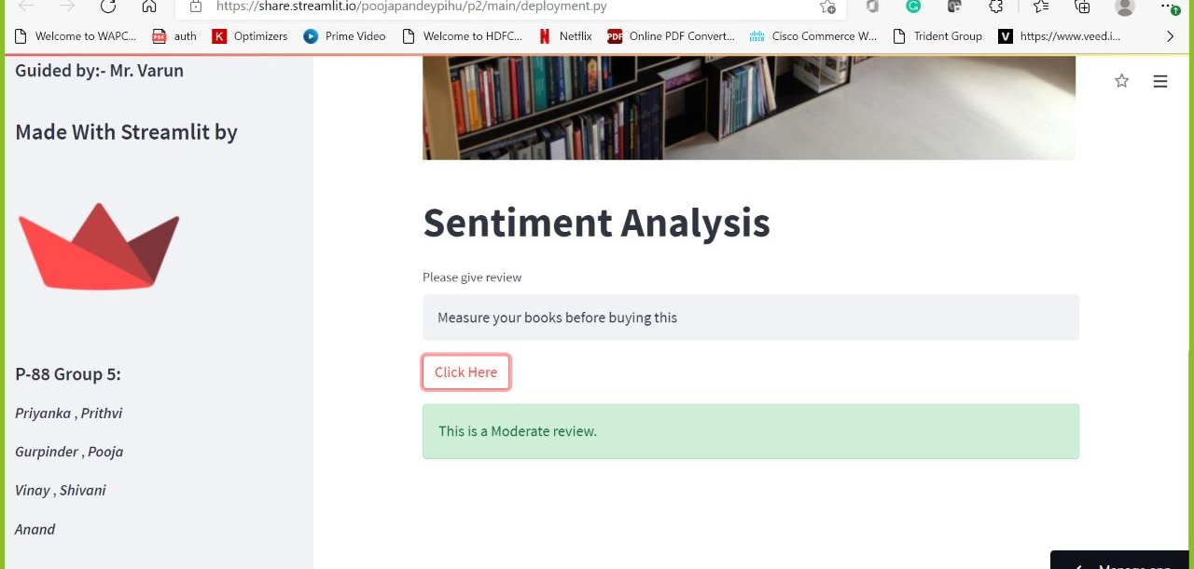
Moderate Review

Slide 15
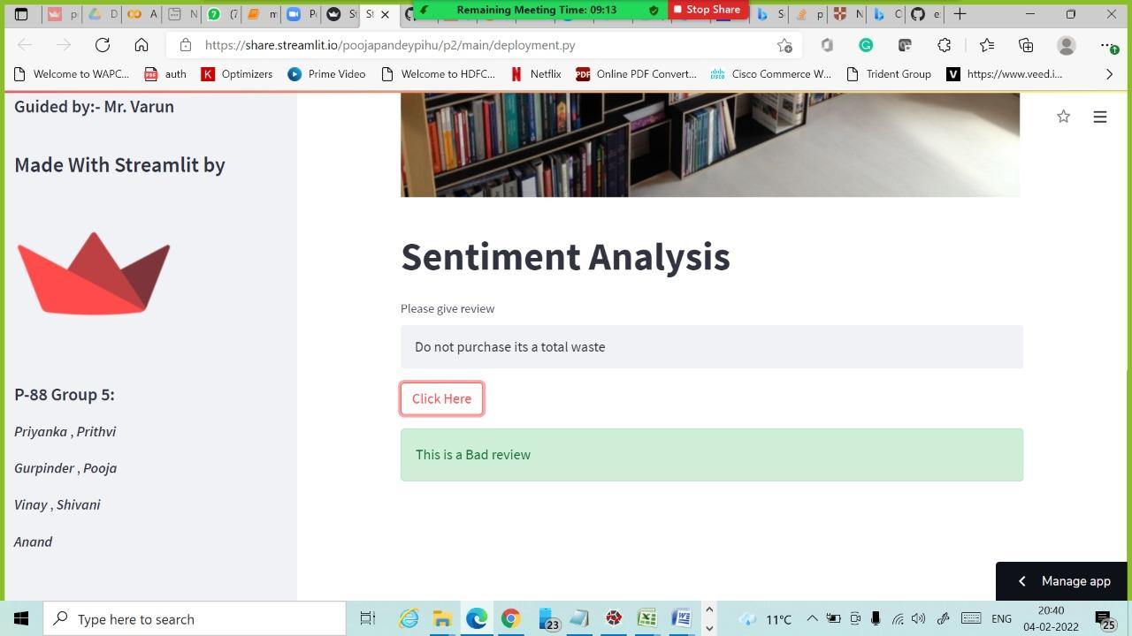
Negative Review
App Link: https://share.streamlit.io/prithviraj-as/bookshelf/main/deployment.py

Slide 16
THANK YOU!

